Slide 1
Introduction to Programming
Flowchart
Diagram representation of algorithm or process

Slide 2
Flowcharts
Flowchart is a diagram representation of an algorithm or process
Flowcharts allow you to design a program without writing any code.
Well suited to procedural code (i.e. C)
Show how control passes through a program (what activity the CPU is doing at any particular time).

Slide 3
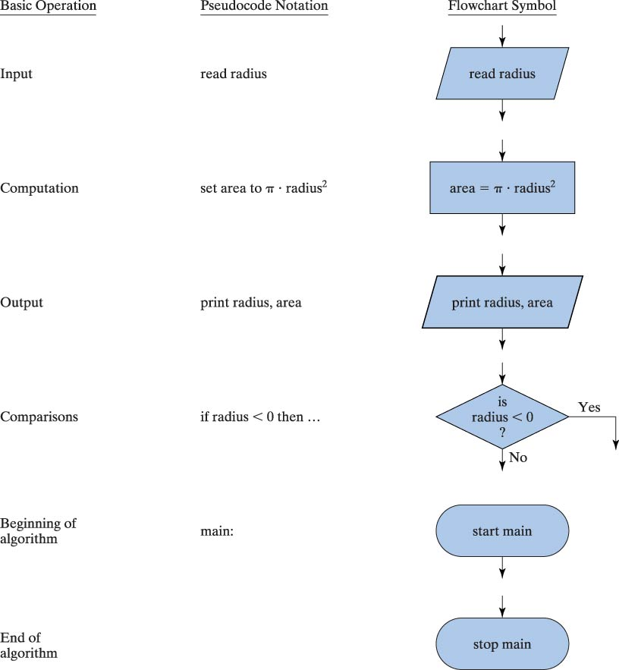
Pseudocode Notation and simplified flowchart symbols

Slide 4
Structured Programming
Sequence
Selection
Repetition
no
yes
no
yes

Slide 5
Flowcharts for Sequential Statements
Start
Input x and y
Total = x + y
Avg= Total /2
Print / Display Avg
End

Slide 6
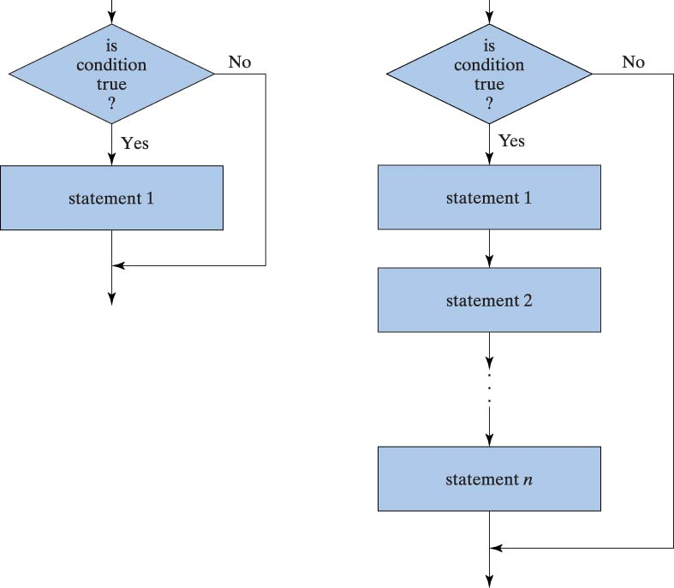
Flowcharts for Selection Statements
True or false depends on
how the “question” is asked

Slide 7
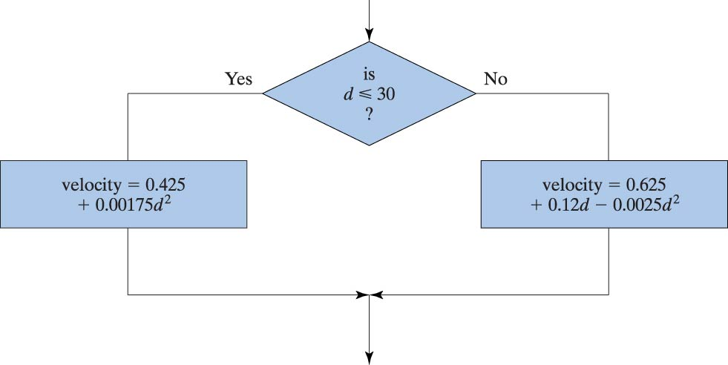
Flowchart for if/else Statement
If (d <= 30)
velocity = 0.425 + 0.00175 * d * d;
else
velocity = 0.625 + 0.12 * d - 0.0025 * d * d;

Slide 8
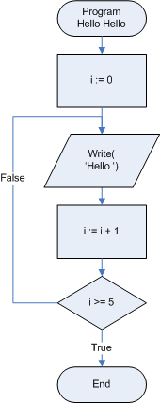
Flowchart for Repetition Statement (Loop)
The flow returns to repeat the actions
Check the condition at the end of the loop

Slide 9
Exercises
Draw a flowchart to find the height of the tallest student in the class and the total number of student in the class:
Start
Tallest = 0
Count = 0
Input height x
x > tallest ?
Yes
tallest = x
No
count = count + 1
Yes
Any more students?
No
Display count and tallest
End

